Slide 1
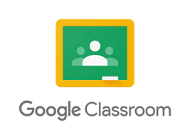
How to Log Into Google Classroom

Slide 2
Visit Ps221q.or or Schools.nyc.gov and click on Teach Hub

Slide 3
Enter your username and password

Slide 4
Click My School
Choose Google Classroom

Slide 5
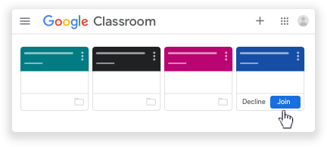
Click on your class
Click Join

