Slide 1
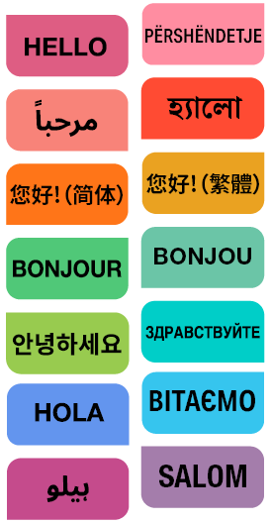
NYC Public Schools Speak Your Language
Presented by:
Office of Language Access
Division of Family, Community, and Student Empowerment

Slide 2





Agenda
1.
NYCPS Background
2.
Our Commitment to NYCPS Families
3.
Raising Awareness in our Communities
4.
Schools.nyc.gov/Hello
5.
Questions

Slide 3








NYCPS Background
1.05+ million students
1,600+ schools​
180+ spoken languages
Approximately 40% of NYCPS households speak a language other than English at home.​
NYCPS' non-English Covered Languages are:
Albanian
Arabic
Bangla
Chinese
French
Haitian Creole
Korean
Russian
Spanish
Ukrainian
Urdu
Uzbek

Slide 4

Our Commitment to NYCPS Families
NYCPS provides free language assistance services to ensure all families can access important information and communicate effectively with school staff. These services include:
Interpretation for all types of meetings and interactions with NYCPS staff (in-person, virtual, and over-the-phone).
Translation of critical communications to ensure parents remain informed in their preferred language.
The Office of Language Access (OLA) is dedicated to supporting both NYCPS staff and families with the resources necessary to effectively communicate in languages other than English.

Slide 5

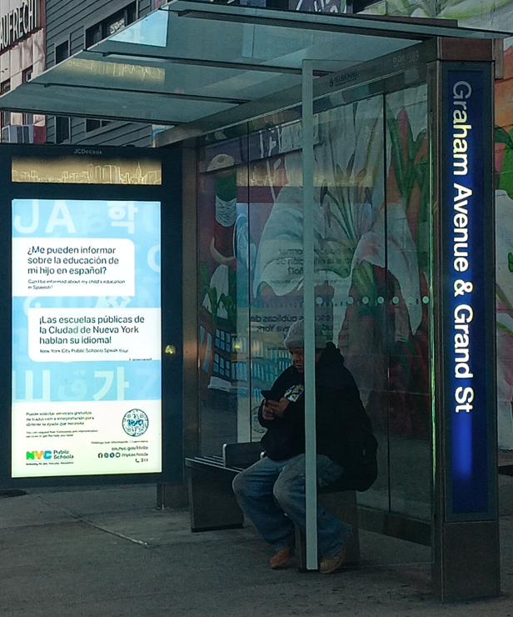
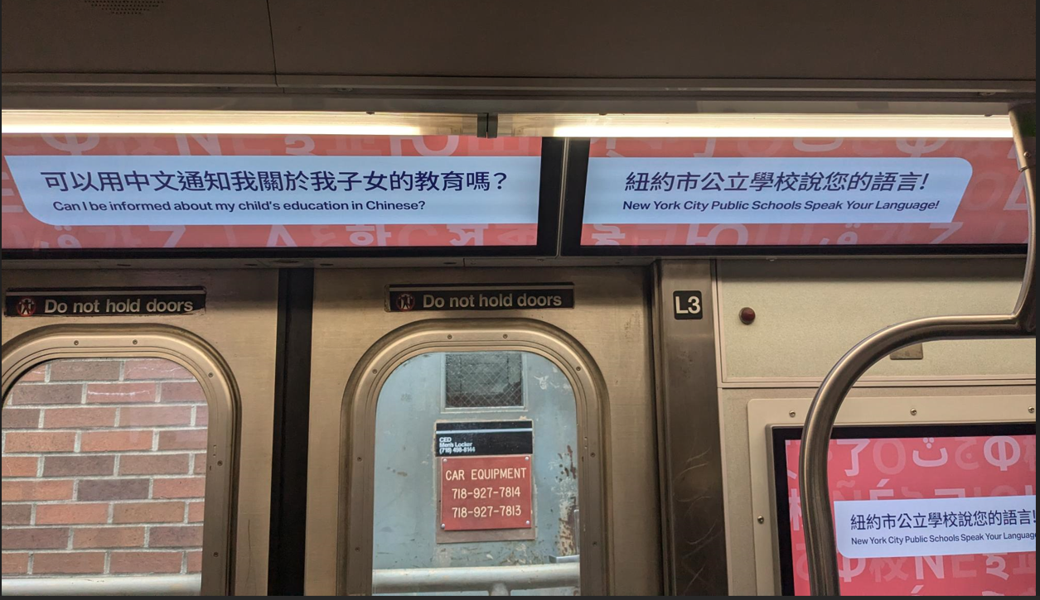
Raising Awareness in Our Communities
General Public Awareness
  Out-of-home ads
    MTA subways and buses
  Print and digital community ads
    Supermarkets, laundromats, salons, barbershops, pharmacies
  Radio, print and digital media
MTA Bus Shelter
MTA Subway

Slide 6
Raising Awareness in Our Communities
Direct Parent Outreach​
  Robocalls​
  Emails​
  Text messages​
  Mailers

Slide 7
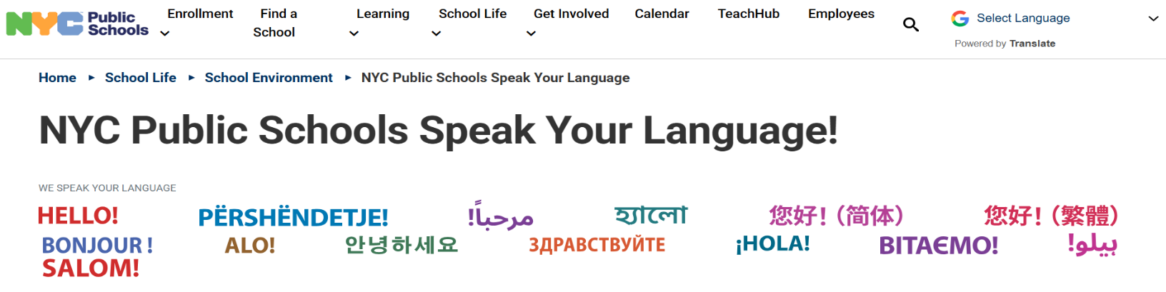

Schools.nyc.gov/Hello
Google Translate has been enabled on the NYCPS website for your convenience. Note: Automated translation is not intended to replace human translations and is provided as a service to visitors of the website.
Arabic| Bangla | Cantonese | French | Haitian Creole | Korean | Mandarin | Russian | Spanish | Urdu Coming Soon: Albanian, Ukrainian, and Uzbek
Notes:
Activity Slide- I will be asking the audience to bookmark the Hello webpage. Tell your story of when you were working at the school and used OPI to help a family. Automated translations are not intended to replace human translators and are provided as a service to users of the website.

Slide 8


Activity
Bookmarking this page sounds like a smart move!
Schools.nyc.gov/Hello
Notes:
Activity Slide- I will be asking the audience to bookmark the Hello webpage. Tell your story of when you were working at the school and used OPI to help a family. Automated translations are not intended to replace human translators and are provided as a service to users of the website.

Slide 9
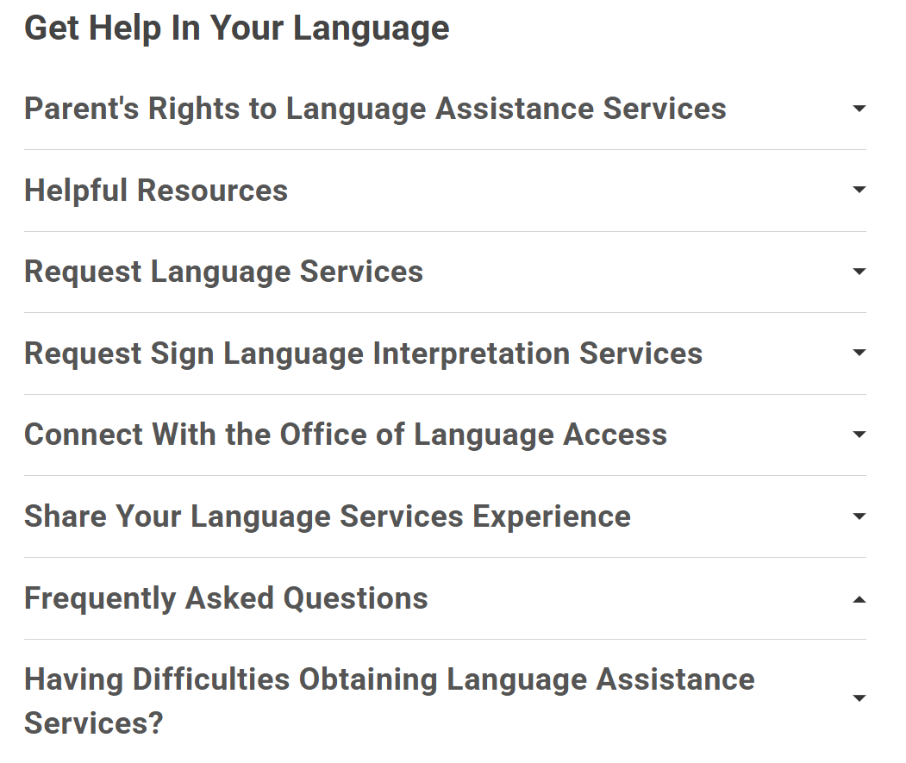
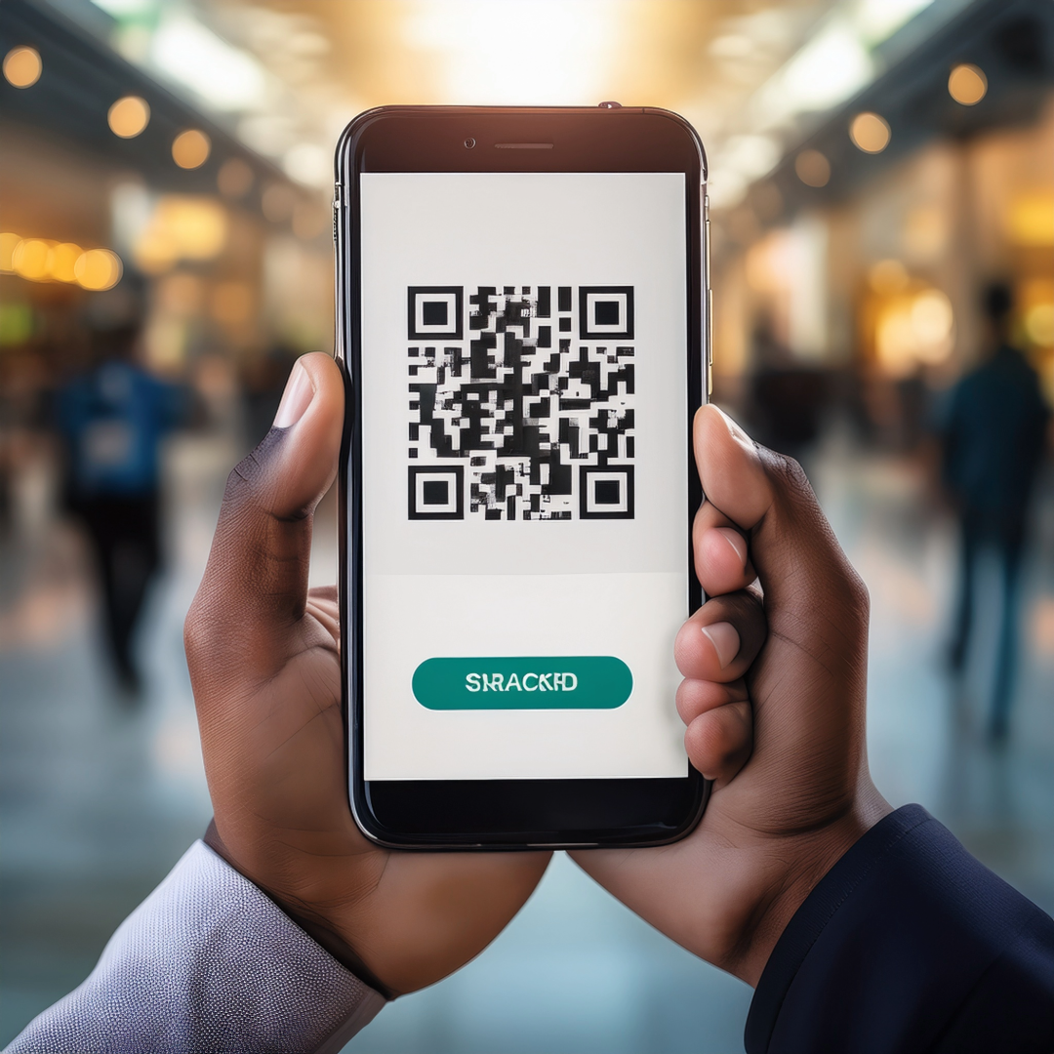
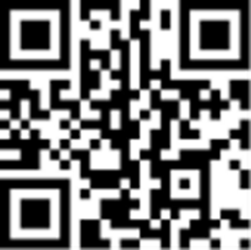
Schools.nyc.gov/Hello
SCAN

Slide 10
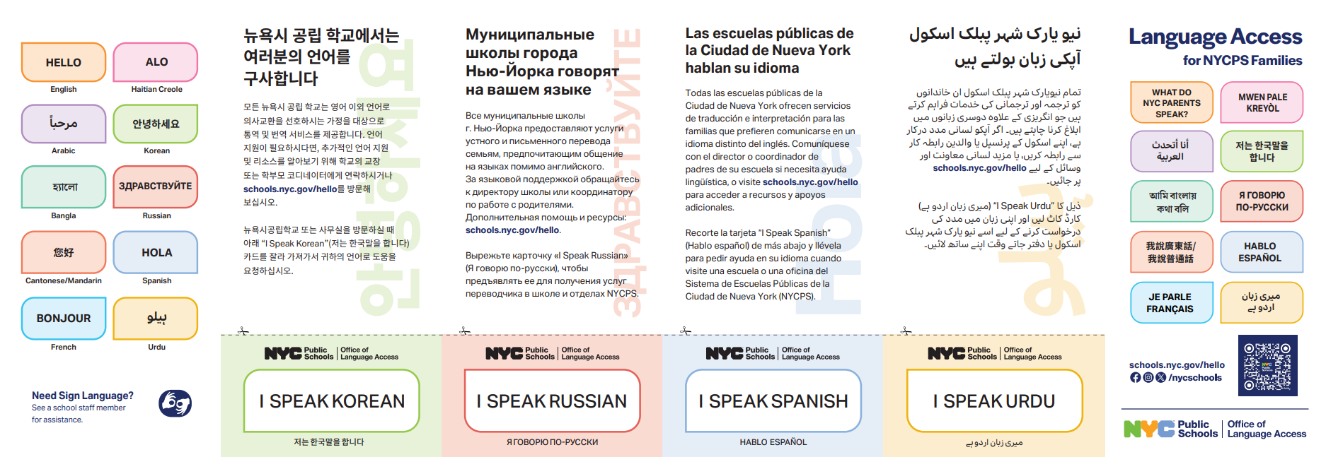
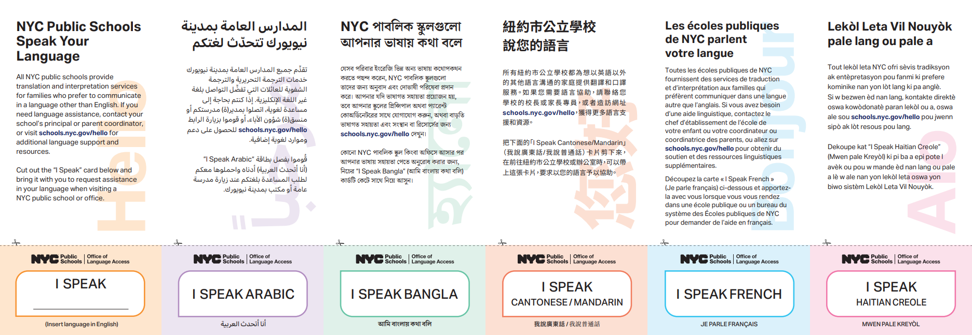

Helpful Resources
The Language Access for NYCPS Families brochure advise families of the availability of language assistance services. Request one at your school!
Language Access for NYCPS Families Brochure
You may also printout language-specific "I Speak" cards to request language assistance services when communicating with NYCPS staff.
Albanian | Arabic | Bangla | Cantonese | French | Haitian Creole | Korean | Mandarin | Russian | Spanish | Ukrainian | Urdu | Uzbek
Don't see your language? Write it in!

Slide 11
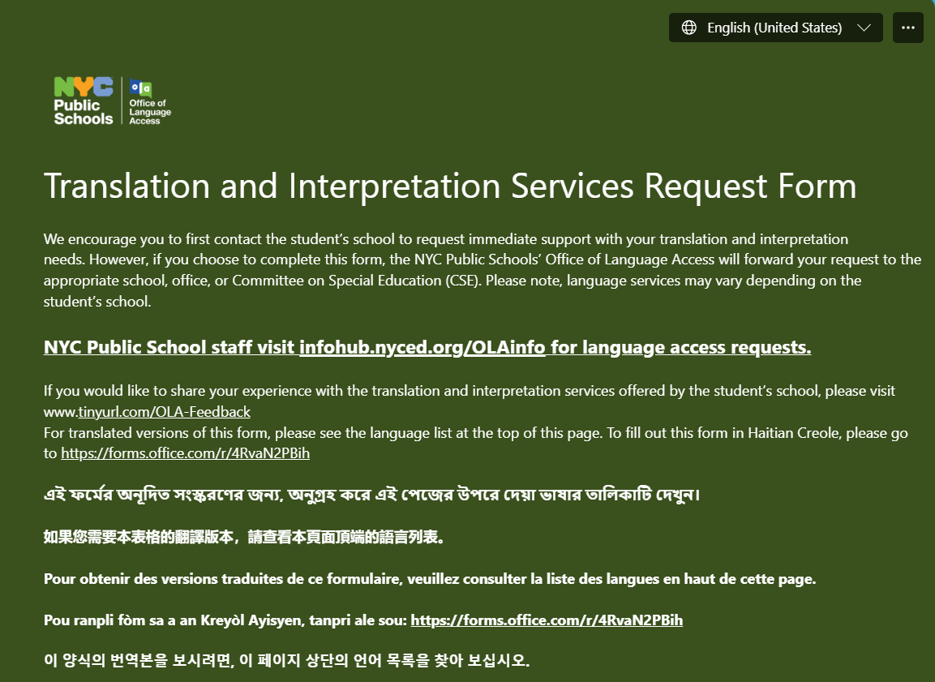
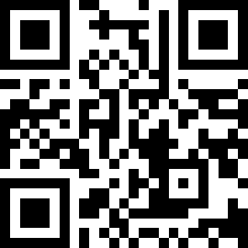
How to Request Language Services
Parents should first contact their student's school for language assistance services.
All requests submitted via the Translation and Interpretation Services Request Form will be forwarded to your student's school or program.
tinyurl.com/TI-Request

Slide 12
How to Request Language Services
Families may request language assistance services at the student's school at any time! Ask the parent coordinator, principal, or complete the Translation and Interpretation Services Request Form to request these services.
The NYC Public Schools’ Office of Language Access (OLA) will forward your request to the appropriate school, office or Committee on Special Education (CSE).
The Translation and Interpretation Services Request Form is available in the following languages:
Arabic | Bangla | Chinese (Simplified) | Chinese (Traditional) | French | Haitian Creole | Korean | Russian | Spanish | Urdu Coming Soon: Albanian, Ukrainian, and Uzbek
Families can also call 311 to make a request for language assistance services. Interpretation, over-the-phone, is available in over 200 languages.
Please note: Language assistance services may vary depending on the school or program the student attends.

Slide 13

How to Request Sign Language Interpreting Services
For American Sign Language interpreting services, please visit NYCPS Office of Sign Language Interpreting Services. You may also contact the Office of Sign Language Interpreting Services at oslis@schools.nyc.gov, or by calling 212-802-1500 x7201 or via video phone at 646-770-1840.
Need Sign Language? See a school staff member for assistance.

Slide 14
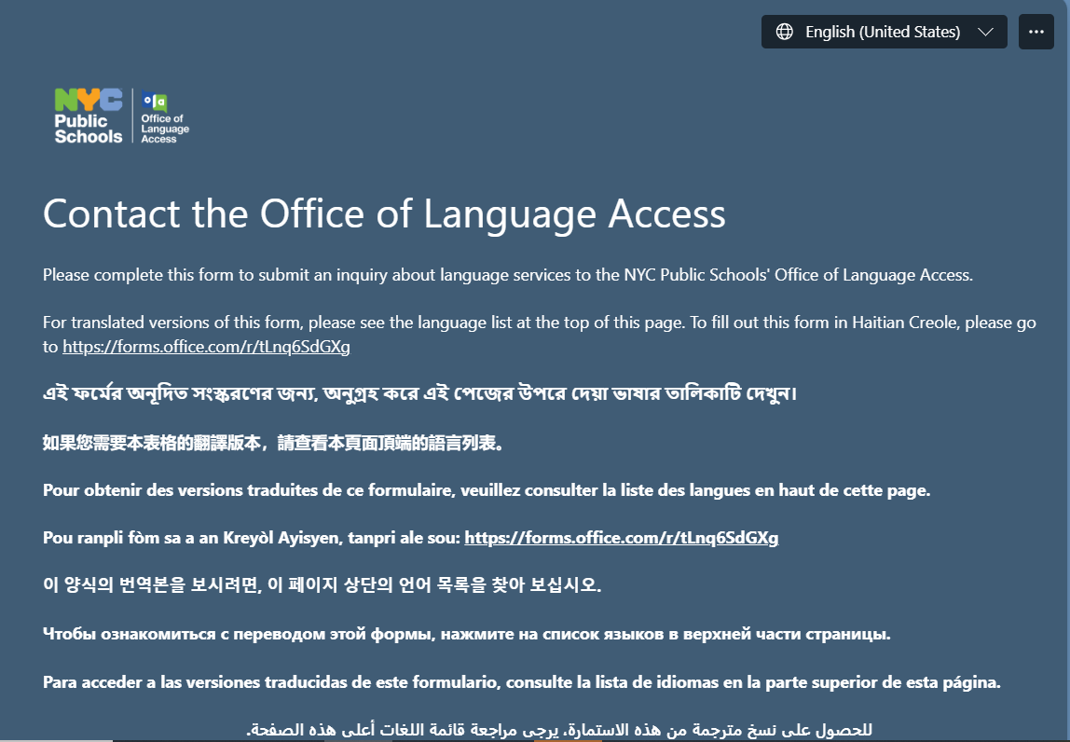
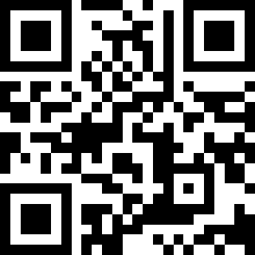
How to Connect with Us
Do you have additional questions about NYCPS' language assistance services?
Complete the Contact the Office of Language Access form.
tinyurl.com/ContactOLA

Slide 15
How to Connect with Us
If you or someone you know needs help receiving information or communicating with a NYCPS staff member in a language other than English, please:
  Contact your school’s parent coordinator, principal
  Call 311
  Visit Contact OLA for support
The Contact OLA form is available in the following languages:
Arabic | Bangla | Chinese (Simplified) | Chinese (Traditional) | French | Haitian Creole | Korean | Russian | Spanish | Urdu
Coming Soon: Albanian, Ukrainian, and Uzbek

Slide 16
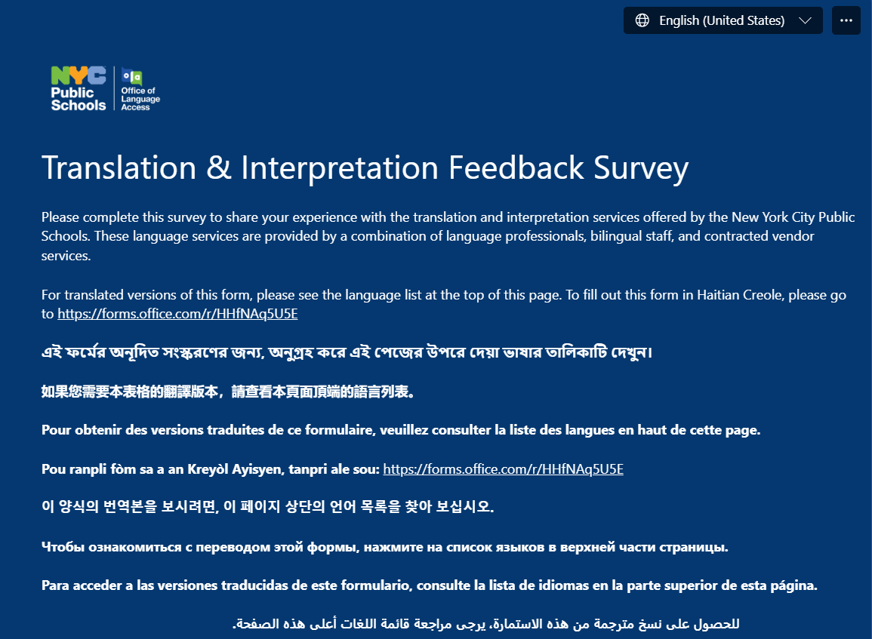
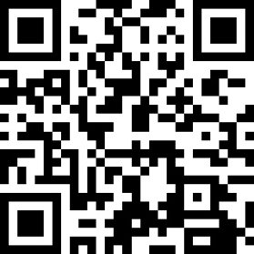
How to Share your Language Service Experience
Tell us how your student's school is doing:
Complete the Translation & Interpretation Feedback Form.
tinyurl.com/OLA-Feedback

Slide 17
How to Share your Language Service Experience
You may provide feedback on the NYCPS' language assistance services by sharing your experience with the school's parent coordinator, principal, completing the Translation & Interpretation Feedback Survey or calling 311.
The Translation & Interpretation Feedback Survey is available in the following languages:
Arabic | Bangla | Chinese (Simplified) | Chinese (Traditional) | French | Haitian Creole | Korean | Russian | Spanish | Urdu
Coming Soon: Albanian, Ukrainian, and Uzbek

Slide 18
Activity
Tell us how your student's school is doing:
Complete the Translation & Interpretation Feedback Form.
tinyurl.com/OLA-Feedback
SCAN

Slide 19

Having Difficulties Obtaining Language Assistance Services?
If you are facing difficulties in obtaining language assistance, we're here to support you!
You can also submit a claim through the Translation and Interpretation Services Complaint Form. Your submission will be reviewed to ensure you receive the support you need.
The Translation and Interpretation Services Complaint Form is available in the following languages:
Arabic | Bangla | Chinese (Simplified) | Chinese (Traditional) | French | Haitian Creole | Korean | Russian | Spanish | Urdu
Coming Soon: Albanian, Ukrainian, and Uzbek

Slide 20



