Slide 1
i-Ready Log In

Slide 2
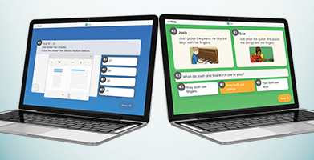
i-Ready
i-Ready is an online program for reading and/or mathematics that will help your student’s teacher determine your student’s needs, personalize their learning, and monitor progress throughout the school year.
The i-Ready Diagnostic is an adaptive assessment that adjusts its questions to suit your student’s needs. Each item a student sees is individualized based on their answer to the previous question. For example, a series of correct answers will result in slightly harder questions, while a series of incorrect answers will yield slightly easier questions. The purpose of this is not to give your student a score or grade, but instead to determine how best to support your student’s learning.
i-Ready Personalized Instruction provides students with lessons based on their individual skill level and needs, so your student can learn at a pace that is just right for them. These lessons are fun and interactive to keep your student engaged as they learn.

Slide 3
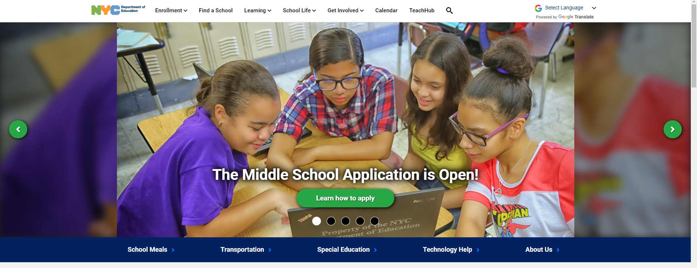
Visit schools.nyc.gov and click on Teach Hub

Slide 4
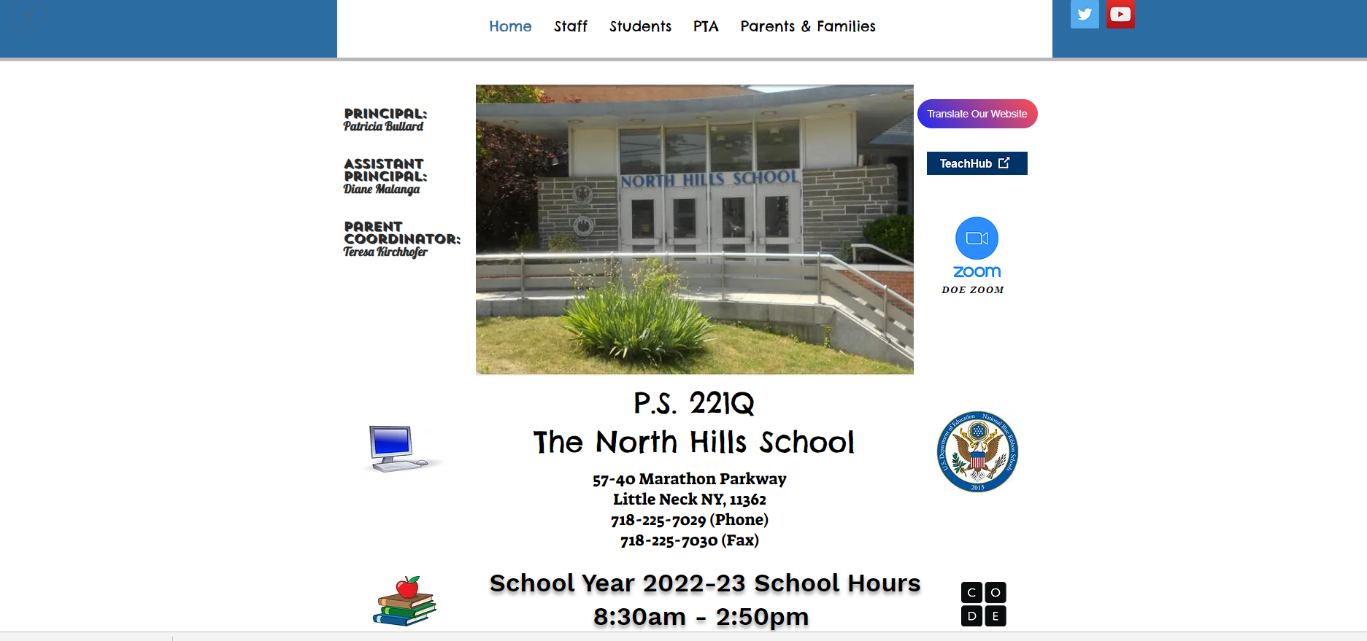
Visit Ps221q.org and click on Teach Hub

Slide 5
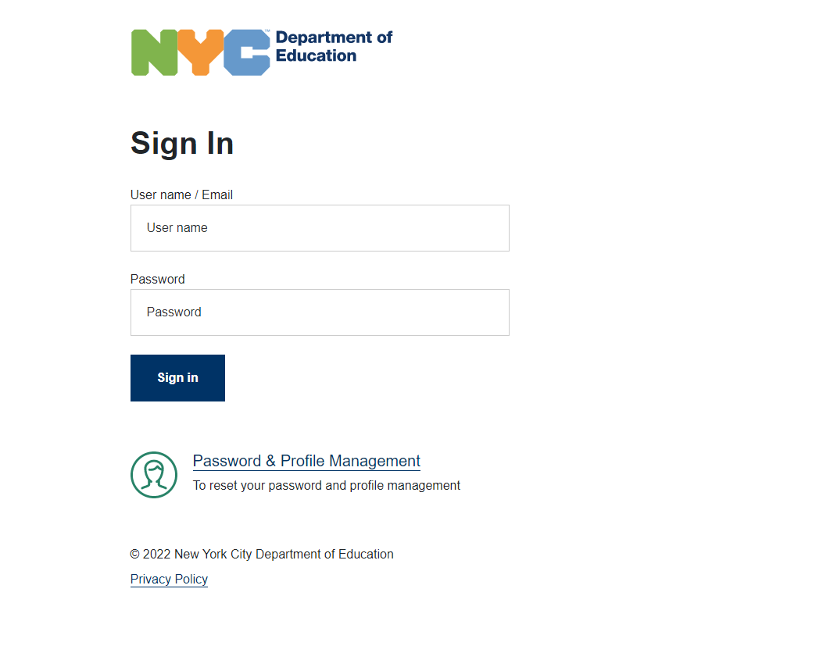
Enter your Teach Hub username and password.

Slide 6
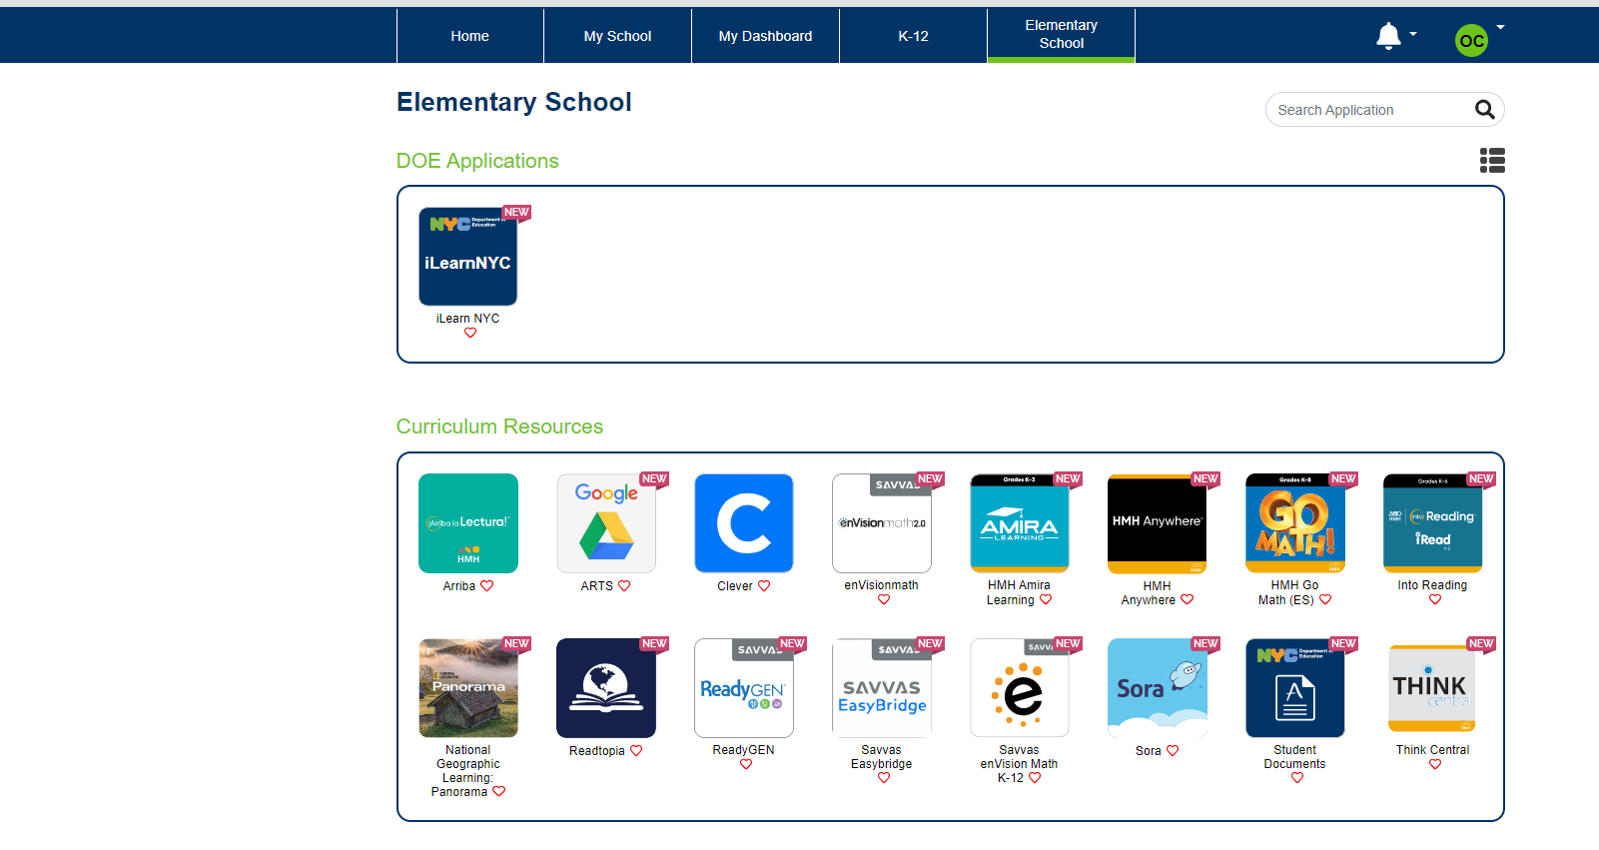
Click on Elementary School.
Search for i-Ready
In the search section, search for i-Ready.

Slide 7
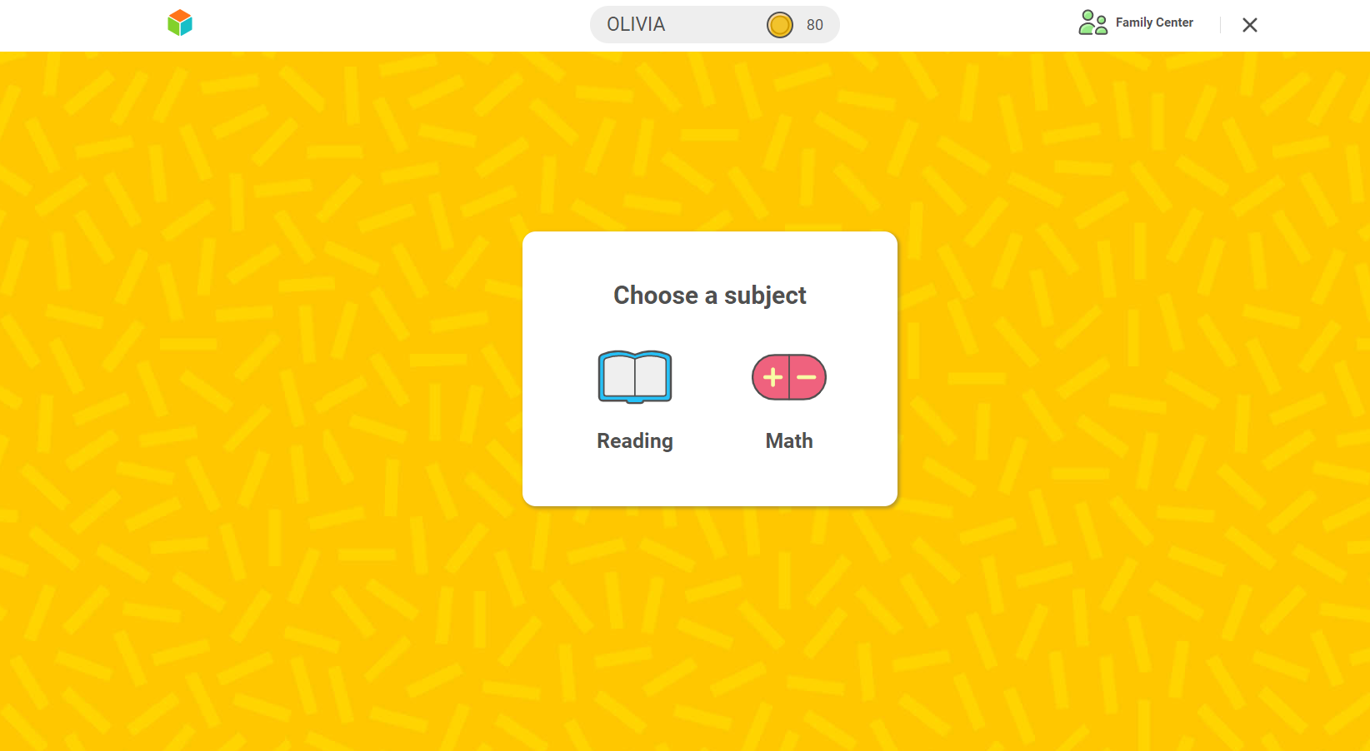

Slide 8
i-Ready on the i-Pad

Slide 9
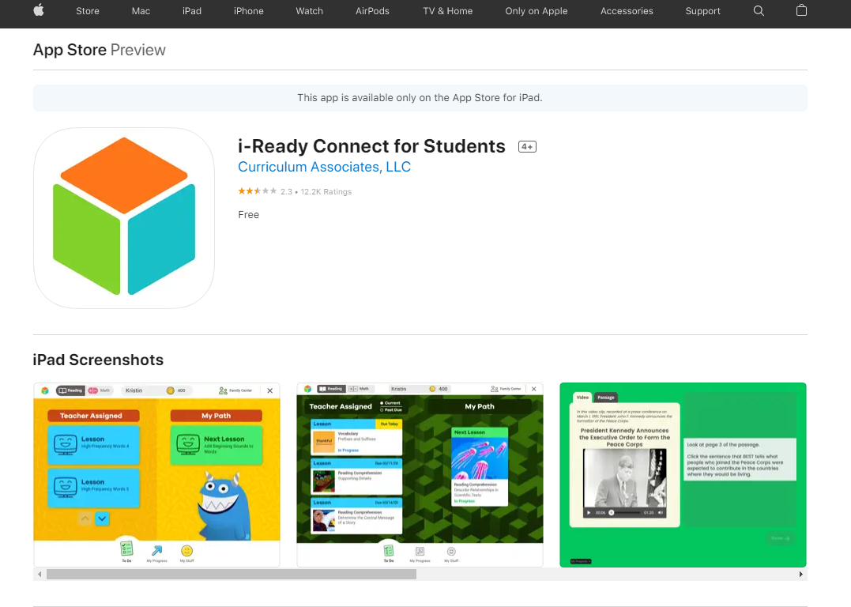
Download the i-Ready Connect App
https://apps.apple.com/us/app/i-ready-connect-for-students/id1155613065
Download the i-Ready Connect app from the app store.

Slide 10
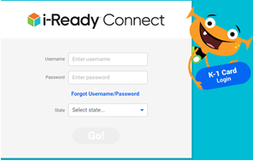
Enter in your username and password and your state. The username and password will be different on the i-Pad than the username you use at Teach Hub. Email Tcaniano@schools.nyc.gov or your child’s classroom teach fs you need an i-Ready i-Pad password.

