Slide 1
TALK TIME
Feb.4
Parent Pointers on Navigating Tech Tools for NYC Public Schools
Presented by: Mrs. Teresa Kirchhofer,
PS221 Parent Coordinator

Slide 2
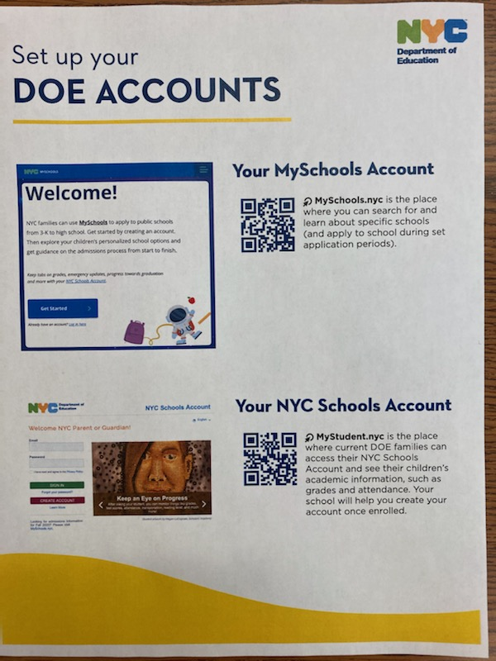

**NYC DOE Accounts
Helpful Online Resources~
SchoolsAccount.NYC -parent portal of student academic records {also called NYCSA} More robust in last few years
MySchools.NYC - online application and directory of
schools & programs
DOE Student Accounts – emails ending in @nycstudents.net
Provides online access to Google Classroom & Iready via TeachHub.
** TeachHub contains curriculum resources & free access to Google Meet, Zoom
Microsoft Office & Adobe

Slide 3
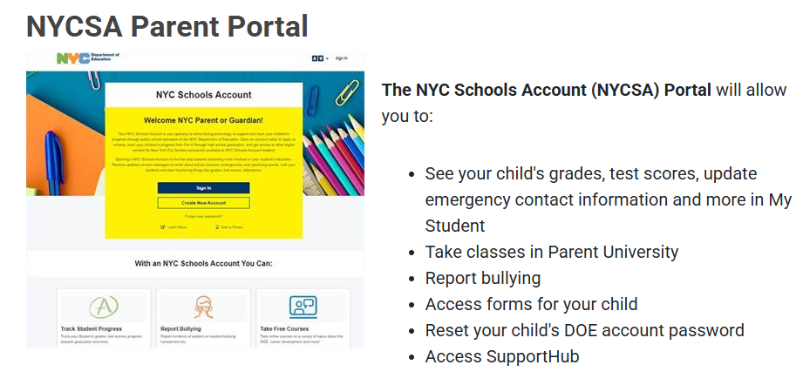
**SCHOOLSACCOUNT.NYC

Slide 4
**SCHOOLSACCOUNT.NYC
Parents create account with their parent email
School sends creation code/multiple children in 1 spot
Access to children’s report card, state assessments
Consent forms – {online blue cards, media consents, manage transportation, report bullying}
Follows student in their NYC Public Schools journey thru high school
Parent University – register & enjoy free courses {careers, wellness, parenting, financial literacy}

Slide 5
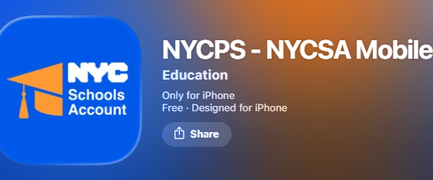
New Mobile APP {NYCSA} mobile app lets families know latest
timely information about their child’s education @ your fingertips.
4 most commonly used functions from the browser-based application~~
MyStudent, (Grades) Assignments, Attendance, IEP
Android ~ download NYCSA application from Google Play Store
Apple/ IOS Devices ~ download Apple NYCSA application from App Store
Follow initial set up steps, & click Log-In with regular username/password

Slide 6
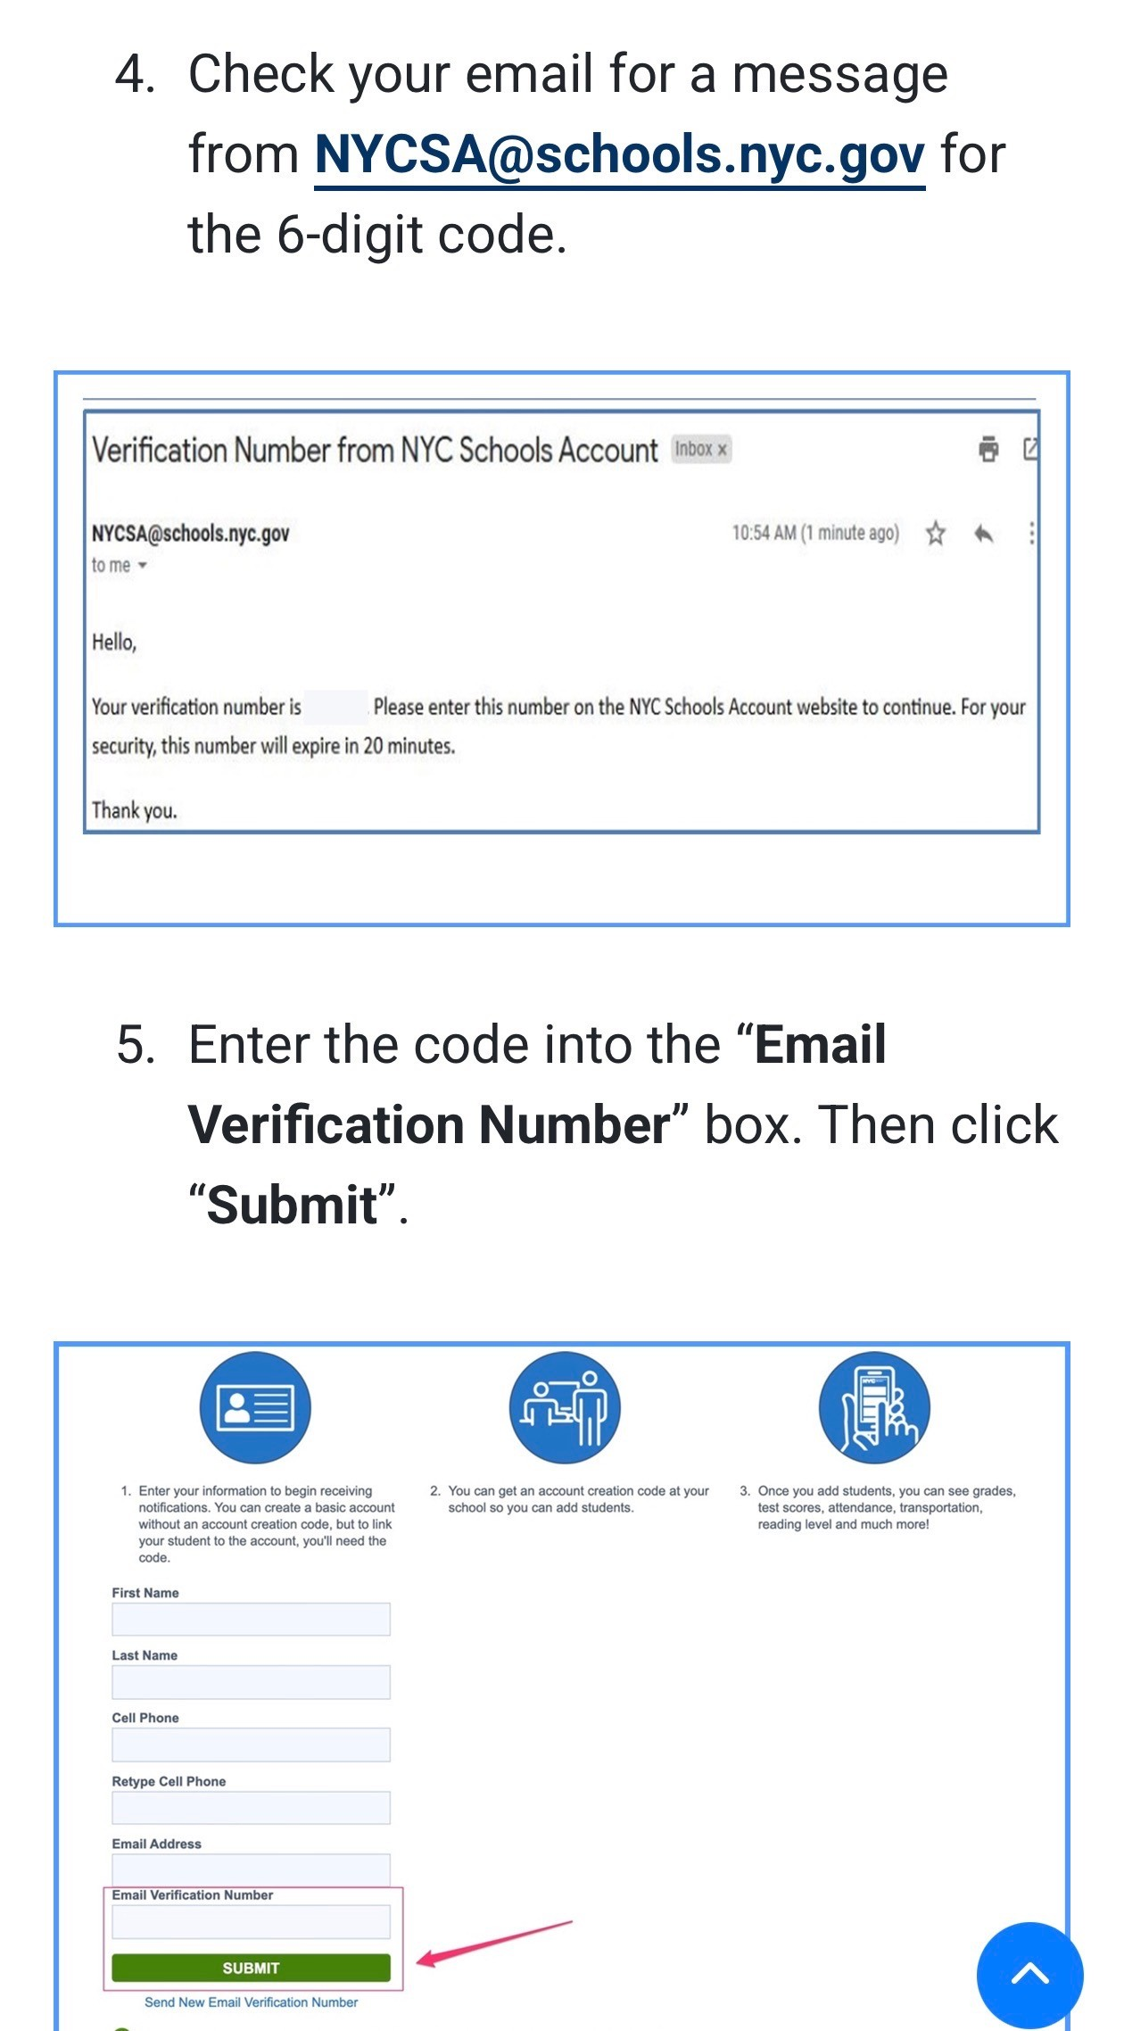
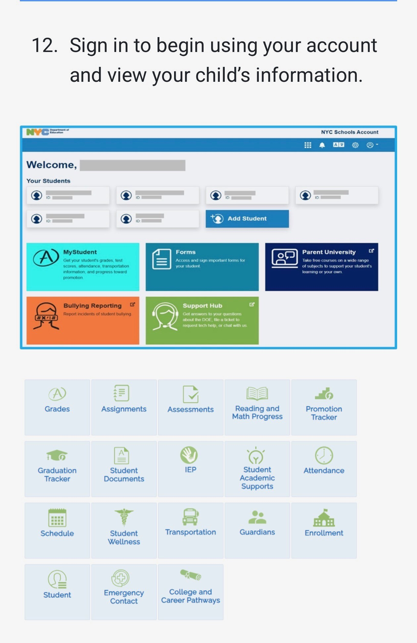
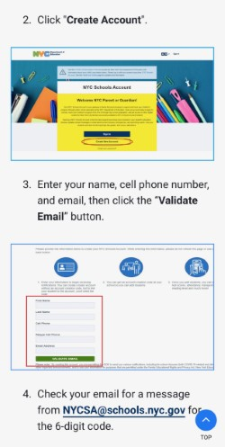
**Set- Up STEPS

Slide 7
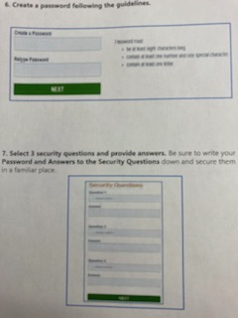
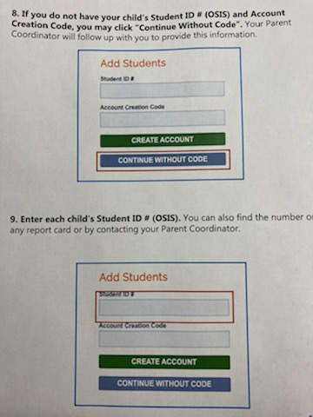
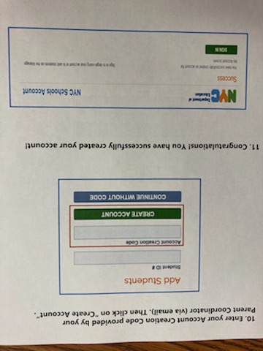
**SCHOOLSACCOUNT.NYC STEPS

Slide 8
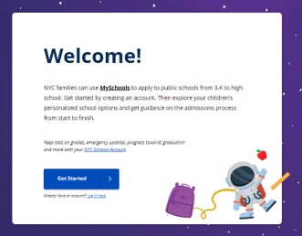
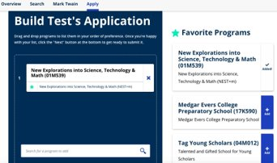
**MYSCHOOLS.NYC Online application to school levels
(3K, PreK, Kindergarten, Middle School,
High School, Summer Rising program)
Parents create account with their parent email.
For middle & high school admissions code is provided.
*** Easily can change language for Translation {top right corner/ bottom bar!! }
Visit schools.nyc.gov/enrollment to learn more.
Each grade has different timeline of open enrollment. Students submit
application online & receive offers {waitlists} electronically.

Slide 9
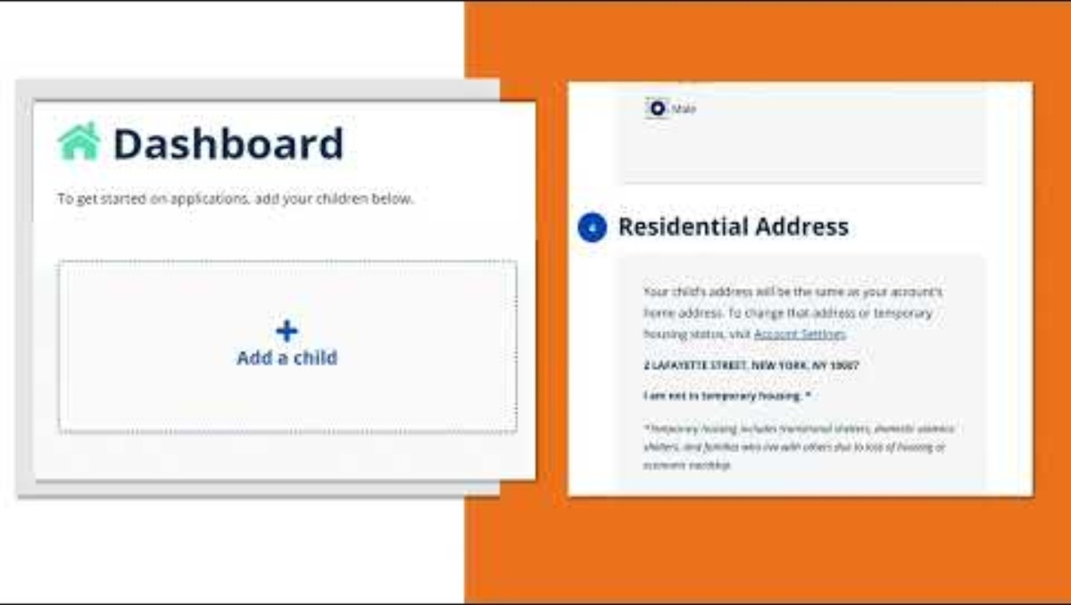
**MYSCHOOLS.NYC Onl Helpful Intro Video

Slide 10

**Student Accounts
Created for all NYC Public School students {ending in @NYCstudents {universal}
This provides access to TeachHub which is where Google Classroom lives.
Used to access assignments & post work in elementary, middle, high
school. Follows students if they move or graduate out.
Also helpful if sick, during remote learning snow days, extended travel
PASSWORDS~ Reach out to me, classroom teacher, Mr. Caniano for Resets
NEW TeachHub Mobile Application {MS/HS} Students have latest education details

Slide 11
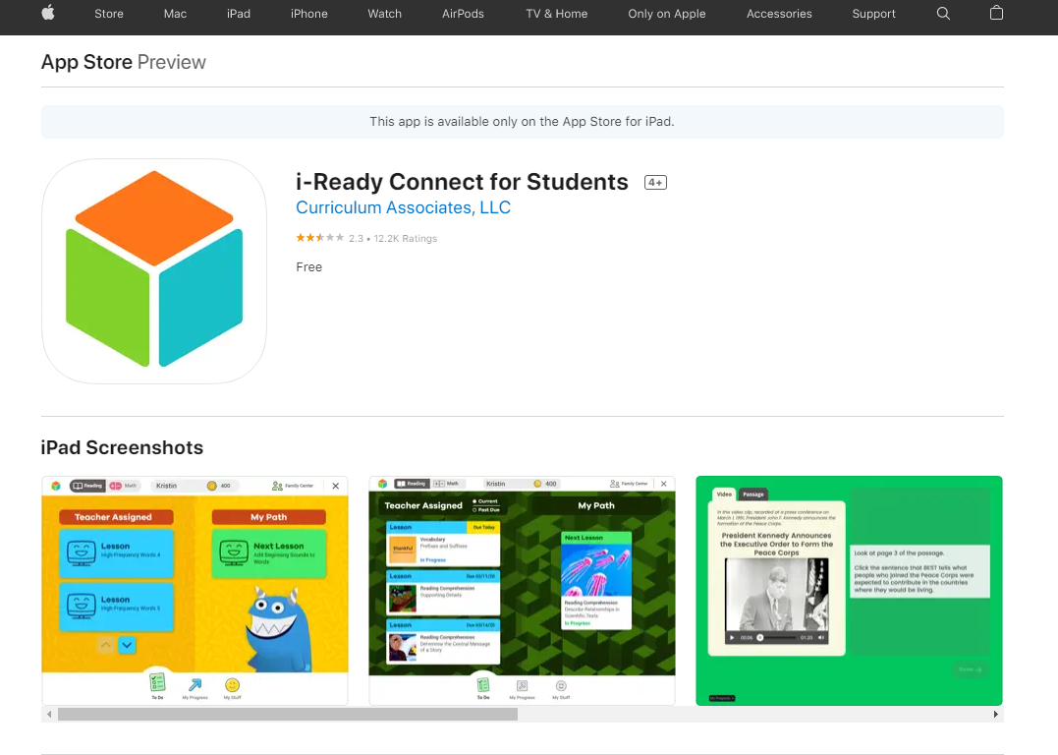
. https://apps.apple.com/us/app/i-ready-connect-for-students/id1155613065
** IREADY
Download the i-Ready Connect App
Download the i-Ready Connect app from the app store.

Slide 12
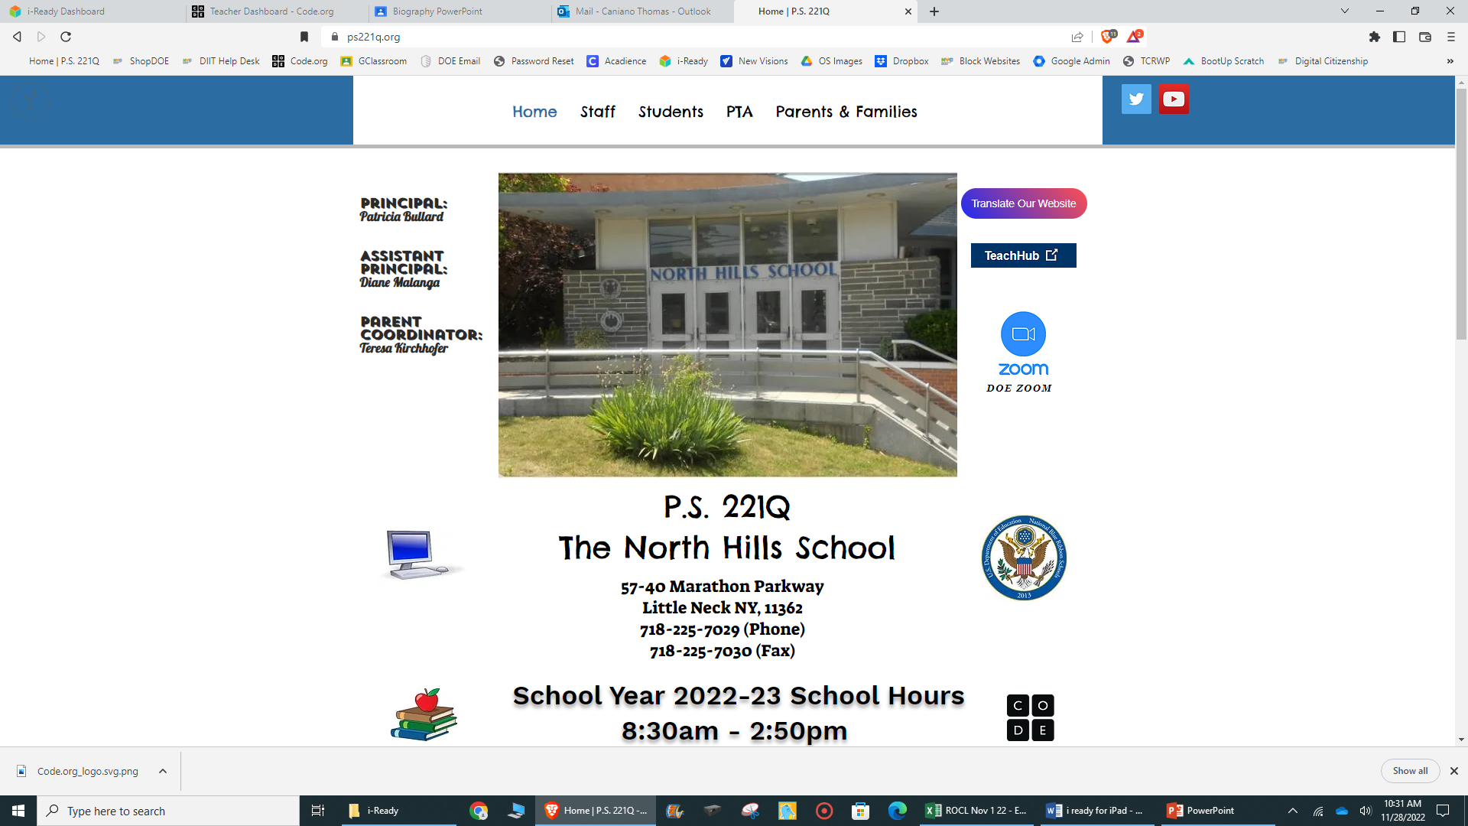
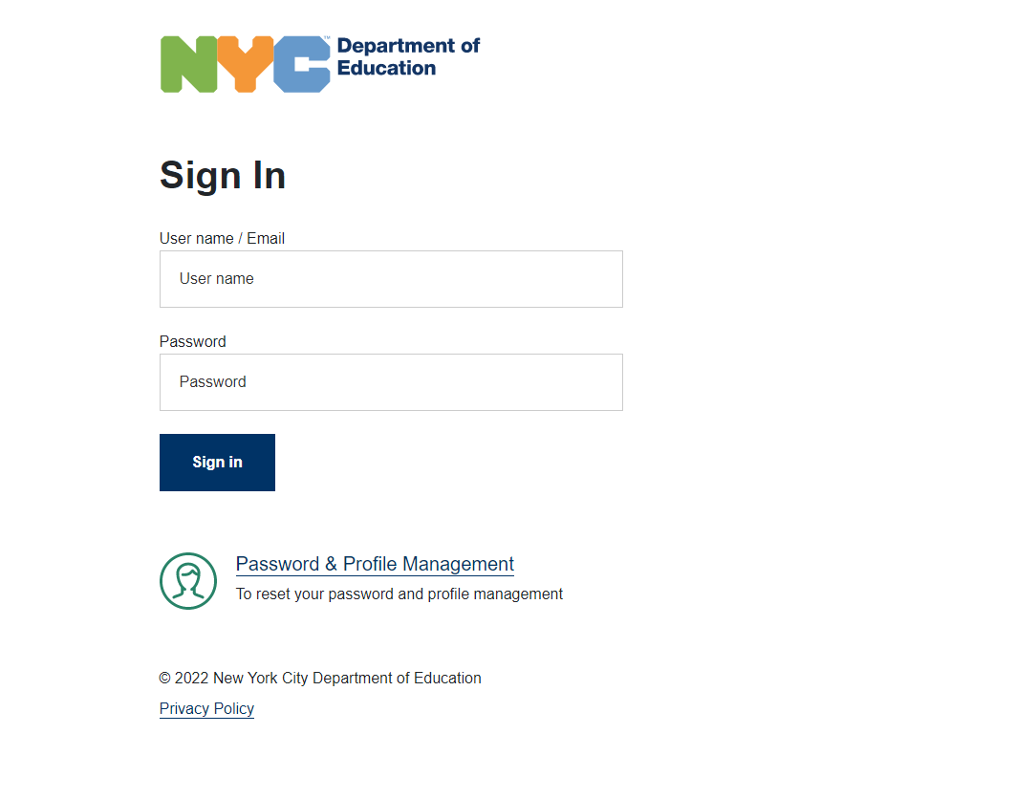
Open Google Chrome and visit Ps221q.org and click on Teach Hub.
** IREADY
Sign in with student DOE UserName and their password
K-2 grades have a #.

Slide 13
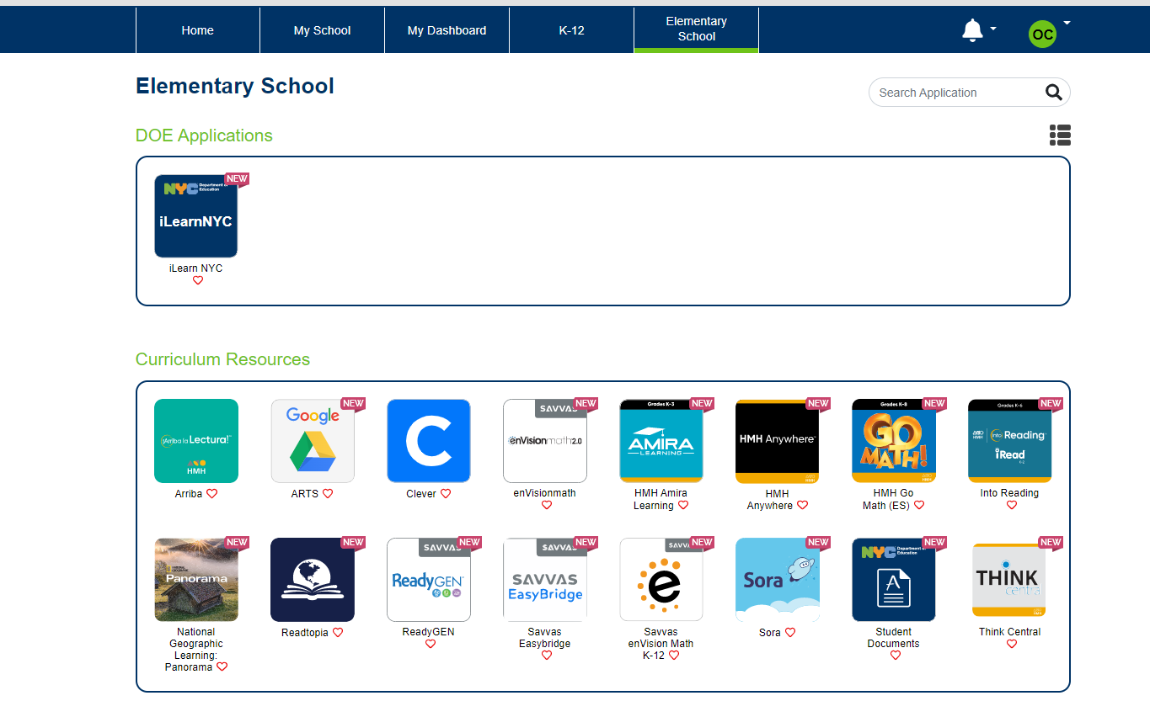
** IREADY
Click on Elementary School.
In the search section, search for i-Ready.
Click on i-Ready.
The i-Ready app should automatically open on the iPad.

Slide 14
Tips: ☺
Families should use the same easy to remember education
password for both SchoolsAccount.NYC & MySchools.NYC.
Parents can share 1 easy login & password for convenience ☺
Always keeps your child’s Student ID OSIS# handy & written
down with both of the above passwords.
Do the same with TeachHub Information. **{Please do not change passwords, classroom teachers have set passwords for login ease!!}
Keep Google Classroom info taped to device students use for Google Classroom Home & also taped in their school folder for in-class assessments.

Slide 15
QUESTIONS
Thank you!!
Tech Help:
**Mr. Thomas Caniano, Technology Teacher
TCaniano@schools.nyc.gov
**Ms. Teresa Kirchhofer, Parent Coordinator
TKirchhofer@schools.nyc.gov

