Slide 1
i-Ready Log In

Slide 2
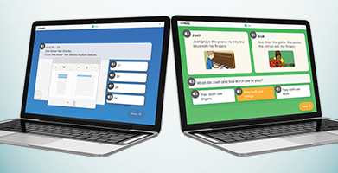
i-Ready
i-Ready is an online program for reading and/or mathematics that will help your student’s teacher determine your student’s needs, personalize their learning, and monitor progress throughout the school year.
The i-Ready Diagnostic is an adaptive assessment that adjusts its questions to suit your student’s needs. Each item a student sees is individualized based on their answer to the previous question. For example, a series of correct answers will result in slightly harder questions, while a series of incorrect answers will yield slightly easier questions. The purpose of this is not to give your student a score or grade, but instead to determine how best to support your student’s learning.
i-Ready Personalized Instruction provides students with lessons based on their individual skill level and needs, so your student can learn at a pace that is just right for them. These lessons are fun and interactive to keep your student engaged as they learn.

Slide 3
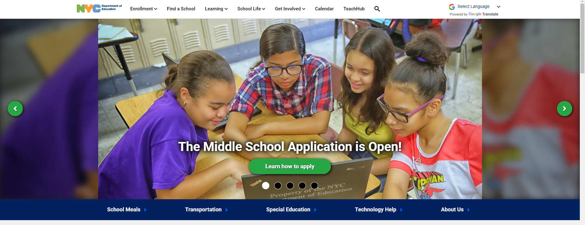
Visit schools.nyc.gov and click on Teach Hub

Slide 4
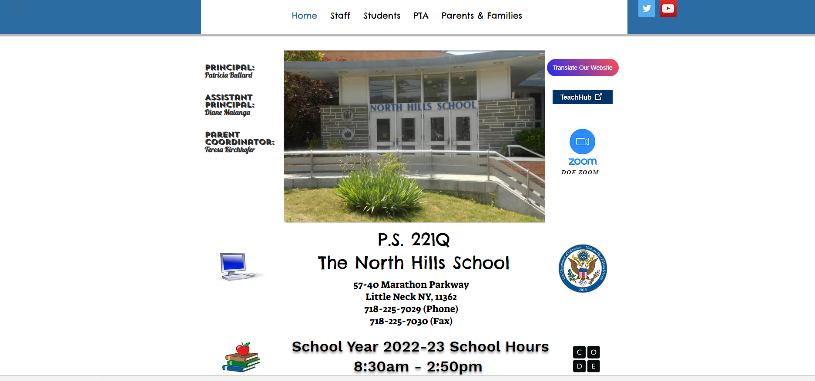
Visit Ps221q.org and click on Teach Hub

Slide 5
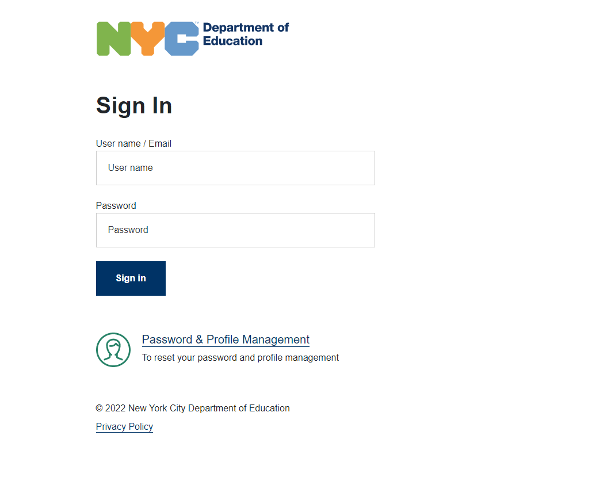
Enter your Teach Hub username and password.

Slide 6
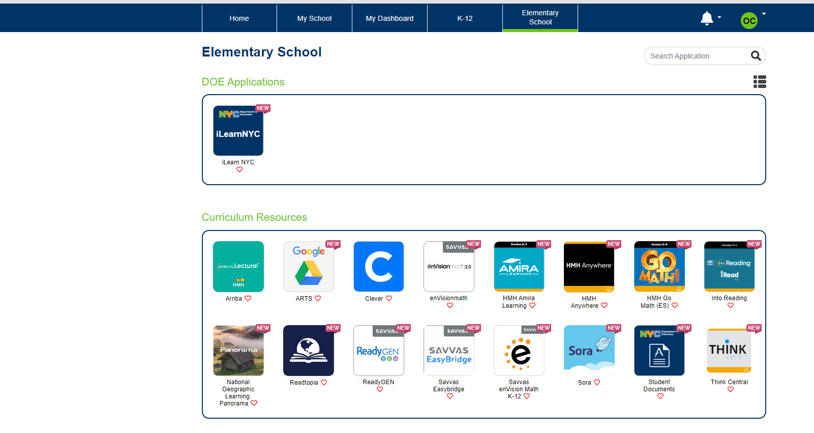
Click on Elementary School.
Search for i-Ready
In the search section, search for i-Ready.

Slide 7
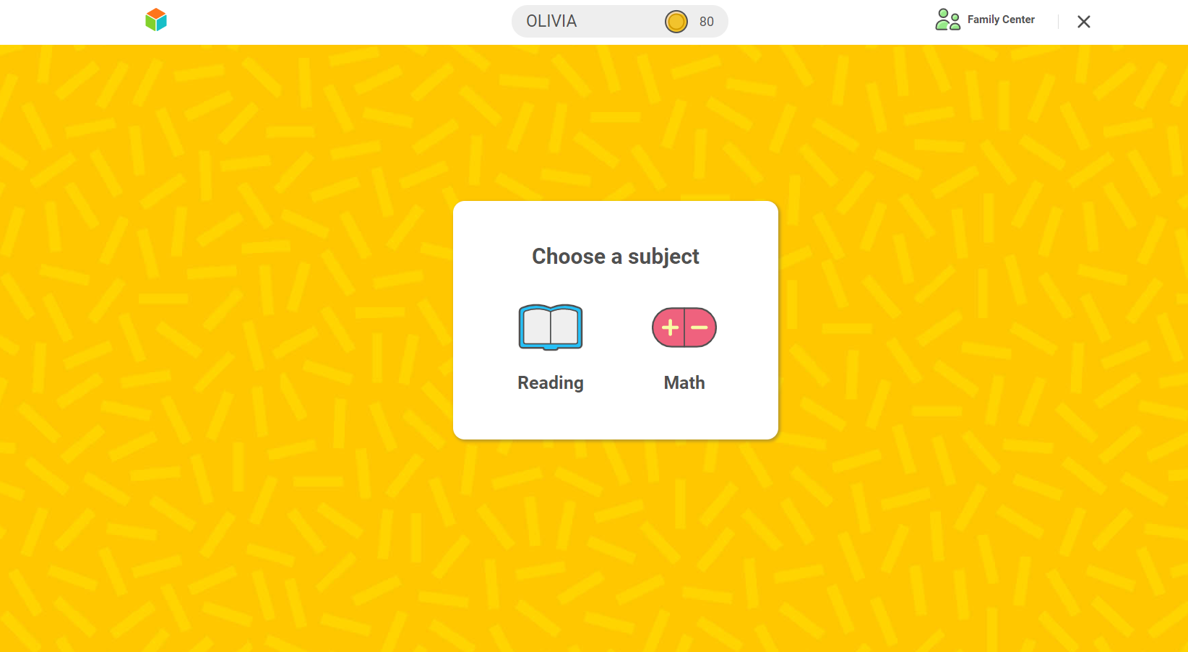

Slide 8
i-Ready on the i-Pad

Slide 9
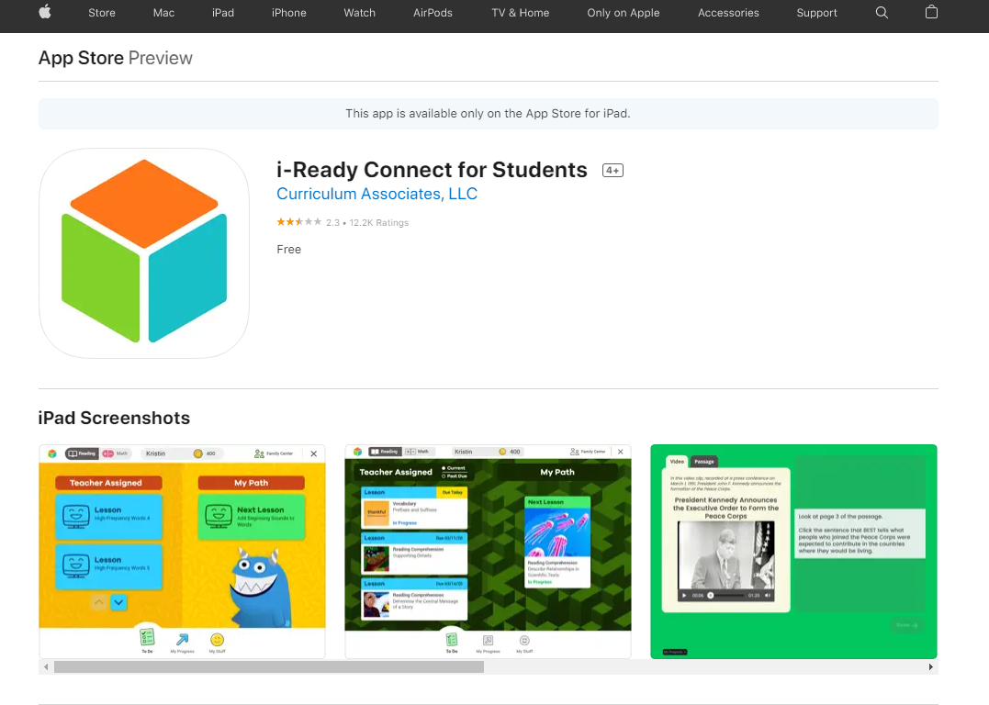
Download the i-Ready Connect App
https://apps.apple.com/us/app/i-ready-connect-for-students/id1155613065
Download the i-Ready Connect app from the app store.

Slide 10
Open Google Chrome and visit Ps221q.org and click on Teach Hub.

Slide 11
Enter your Teach Hub username and password.

Slide 12
Click on Elementary School.
Search for i-Ready
In the search section, search for i-Ready.
Click on i-Ready.
The i-Ready app should automatically open on the iPad.

